Slide 1
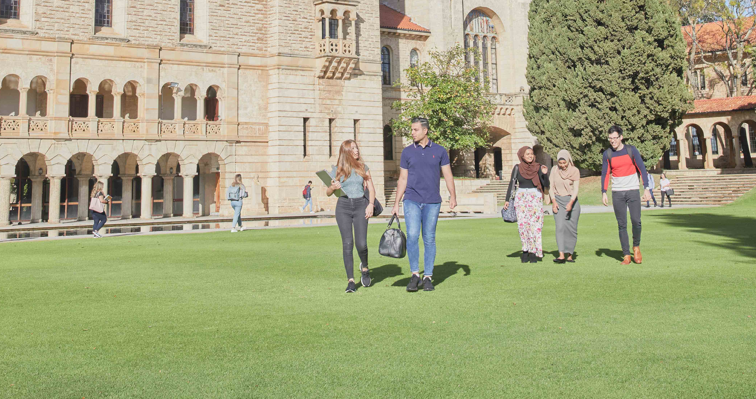
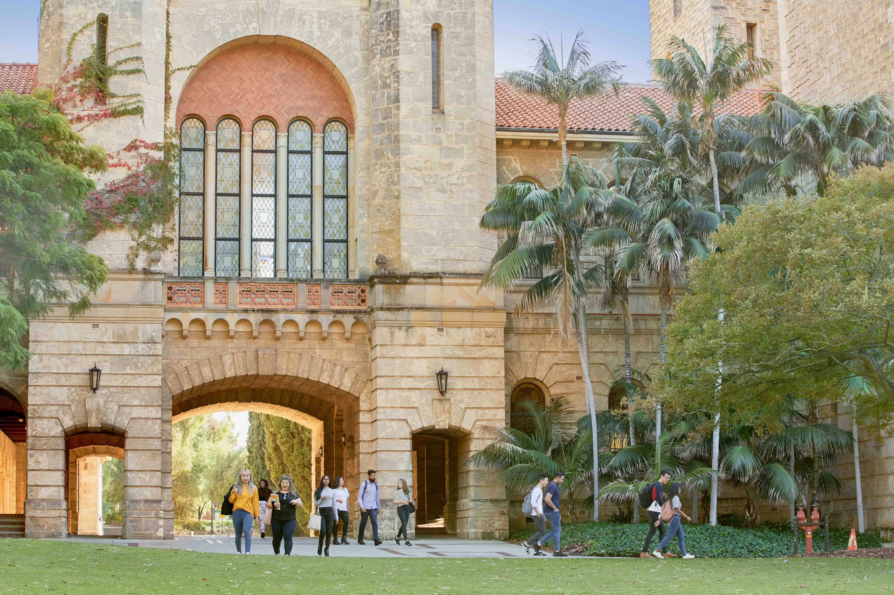
CITS5553
Data Science Capstone Project - Group 08
Ming ZHOU

Slide 2
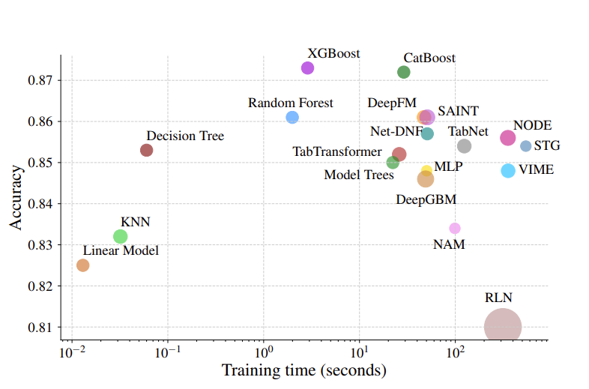
Model Selection
Given the nature of the data, high-dimensional sparse tabular data.
ML tree-based: XGBoost, LightGBM, CatBoost
DL: TabNet

Slide 3
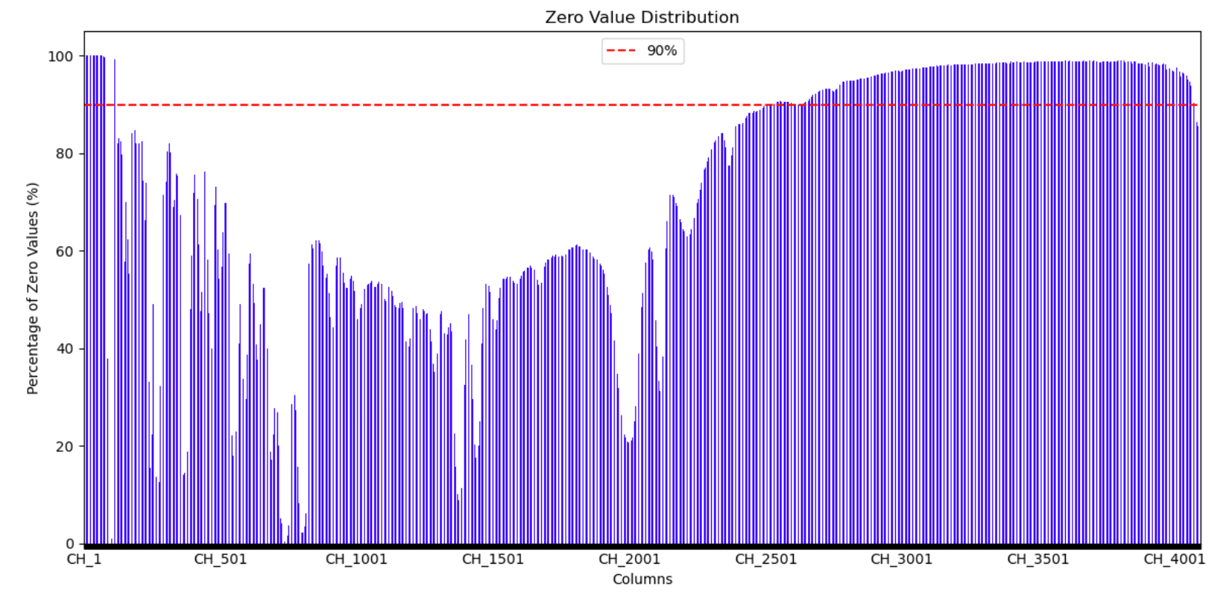
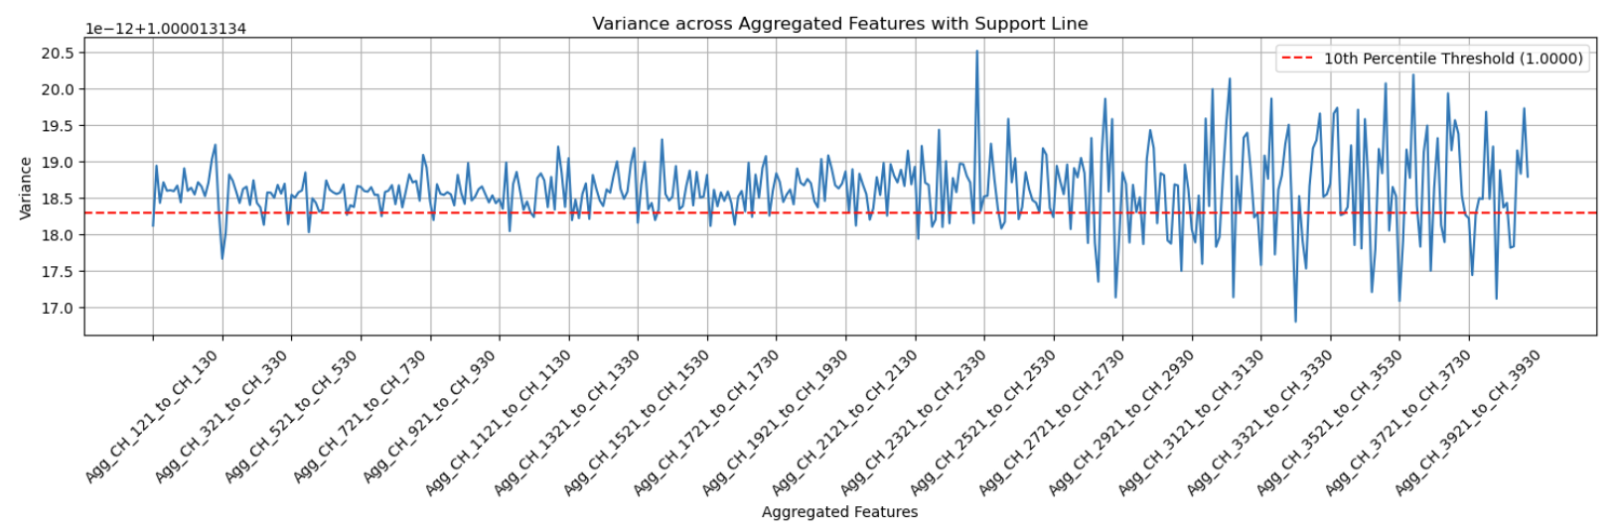
Data Preparation & Pre-Processing
The dataset focuses on the first 24 most common Mineral Phases, randomly sampling from the data pool, each one will have around 10 000 samples for training.
The data set has been pre-processed through getting rid of the columns of first 120 and 2330 till the last and been aggregated through summing for every 8 columns.

Slide 4
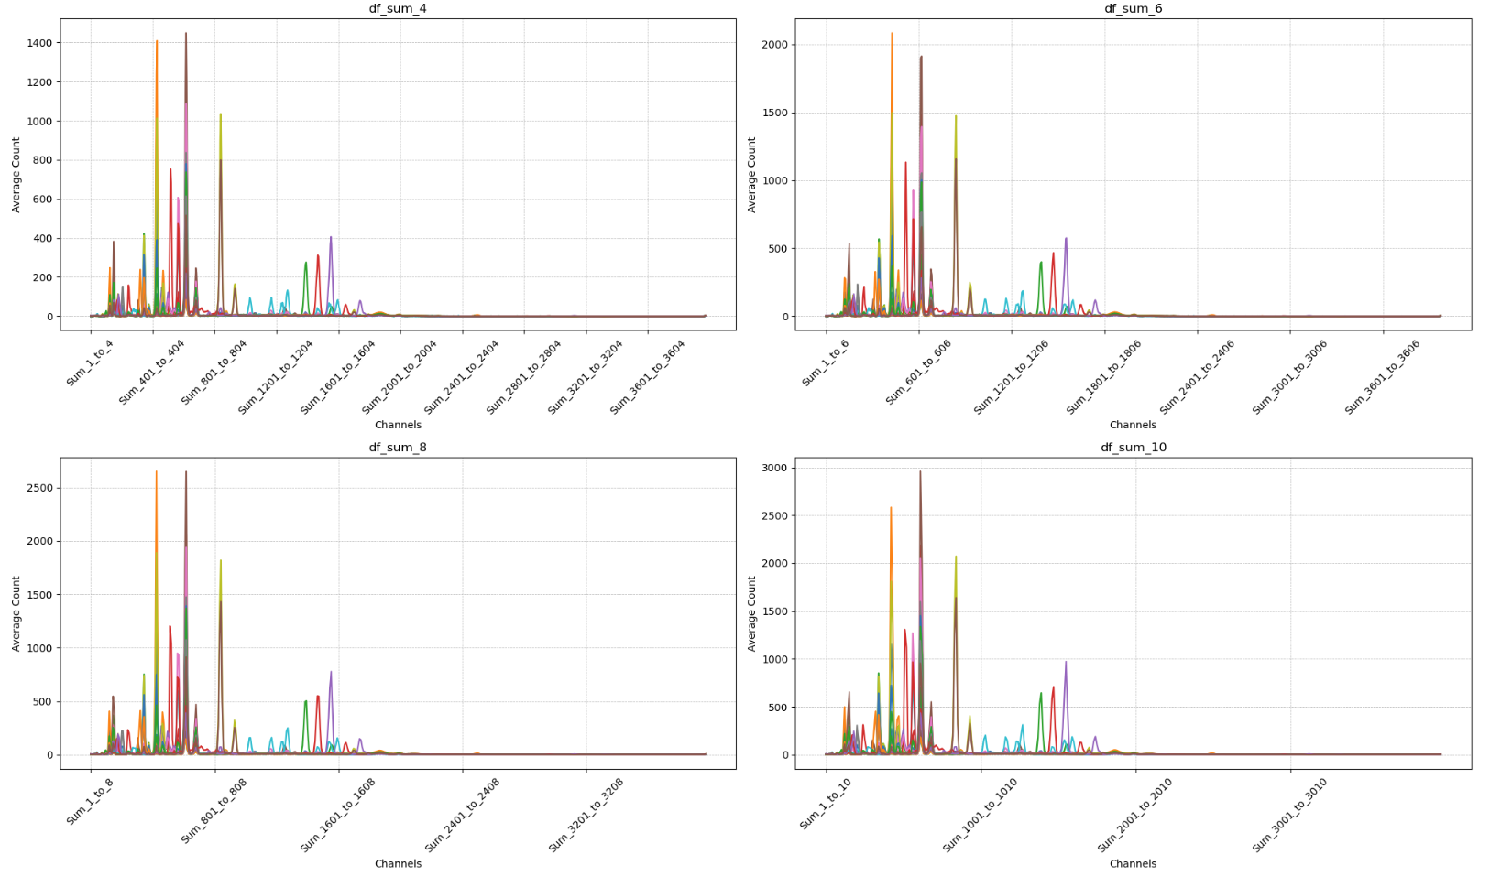
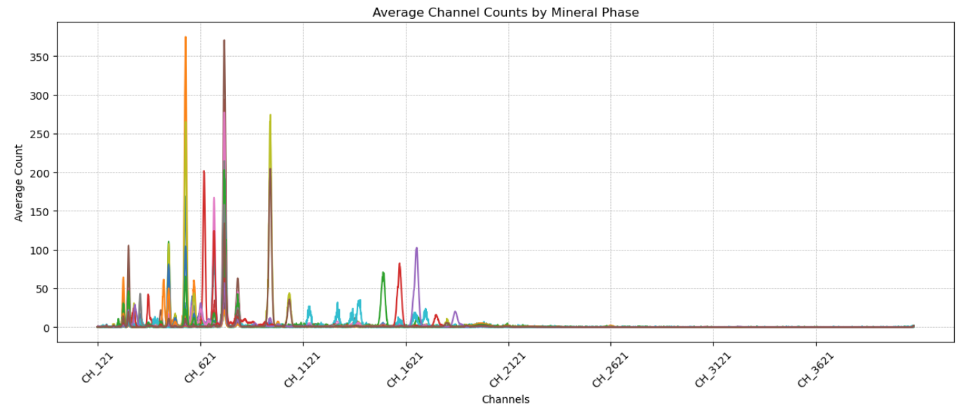
Data Pre-Processing
Aggregate by 8 columns

Slide 5
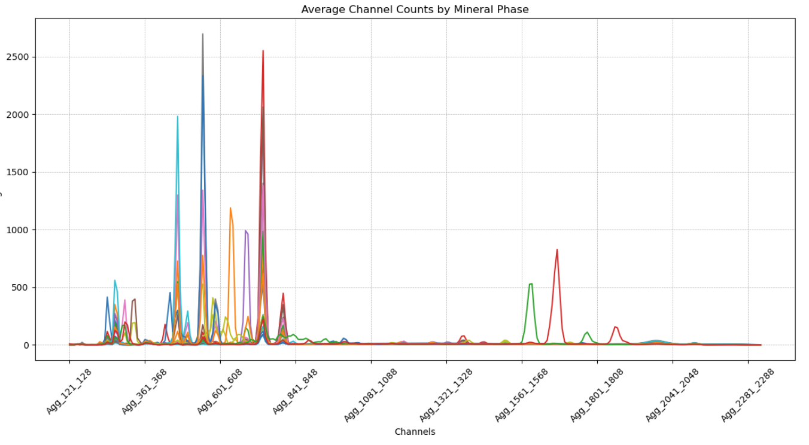
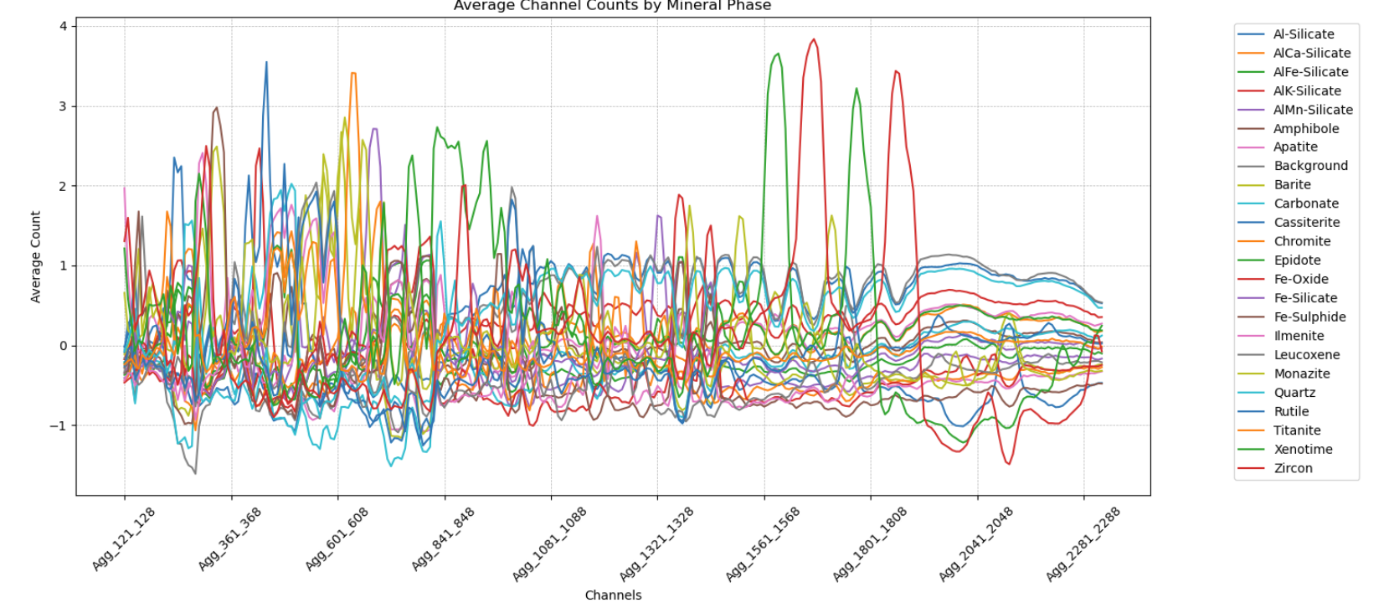
Data Pre-processing
Data set is split into training and testing through 80:20 ratio.
Data has been processed through standard normalization under log scale.
Same scaling for testing sets.

Slide 6
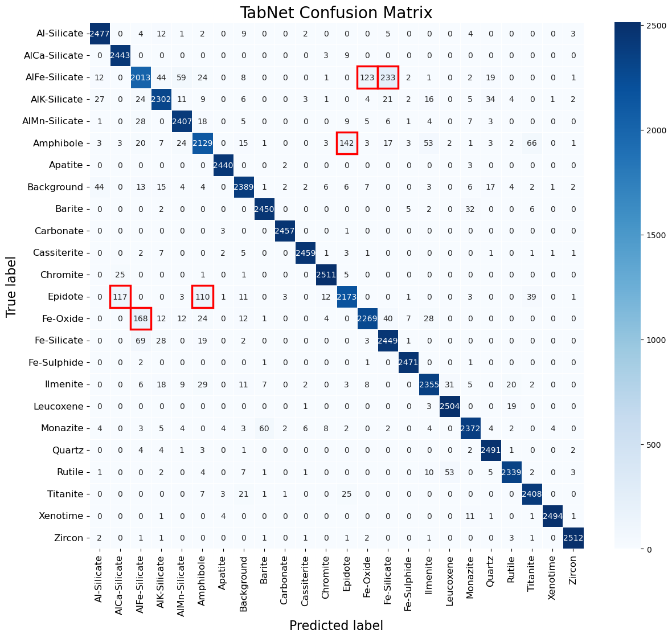
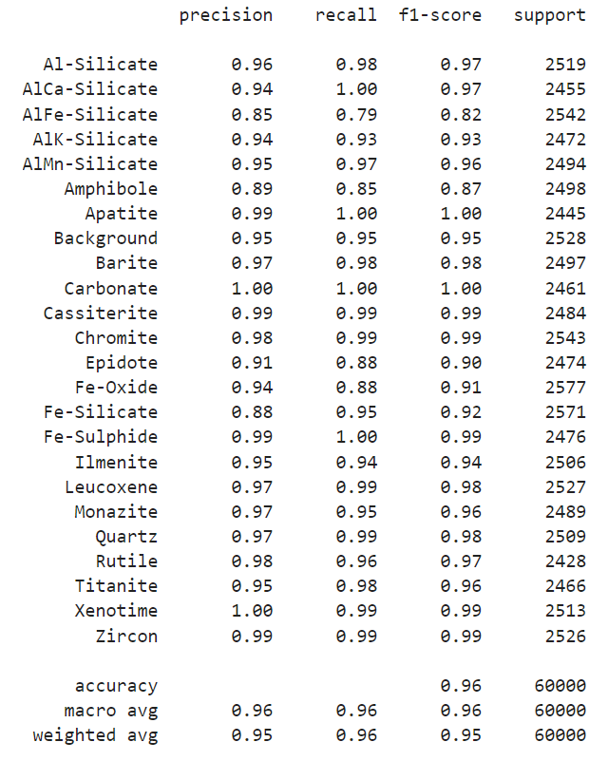

TabNet

Slide 7
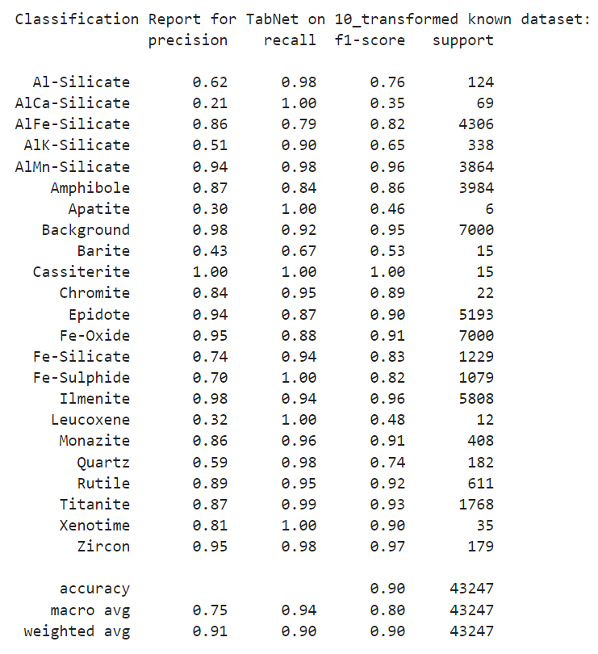
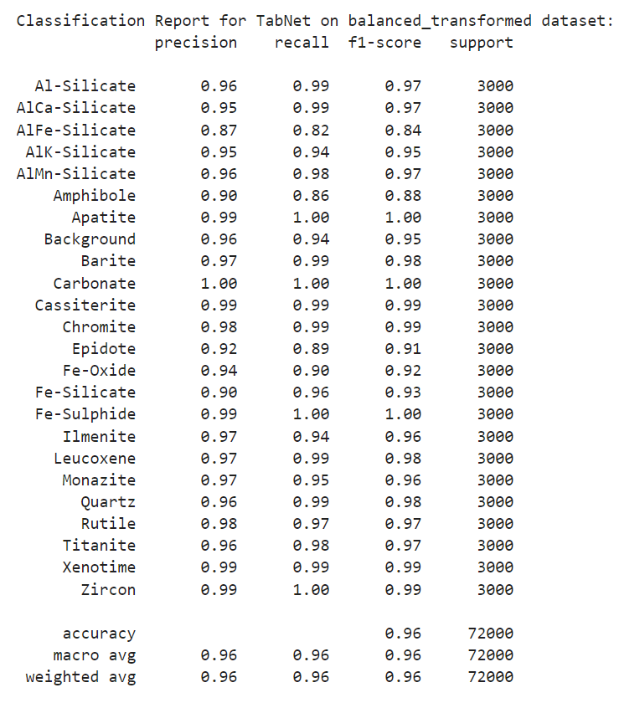
TabNet

Slide 8
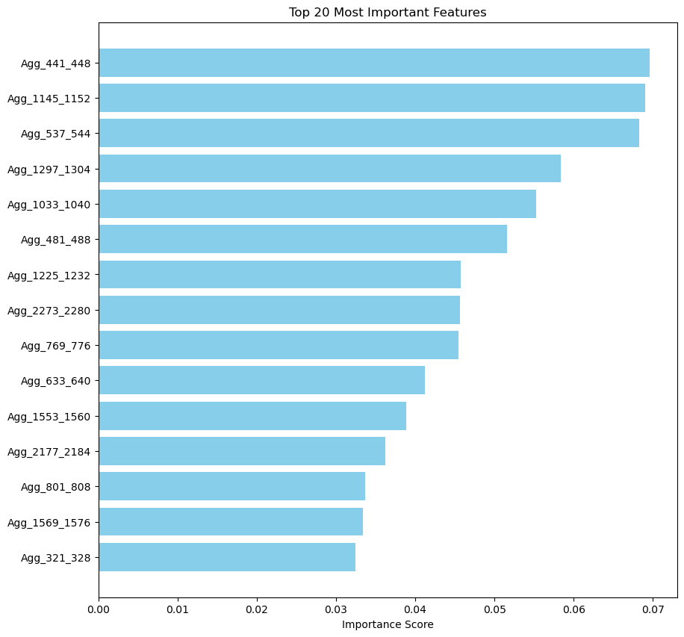
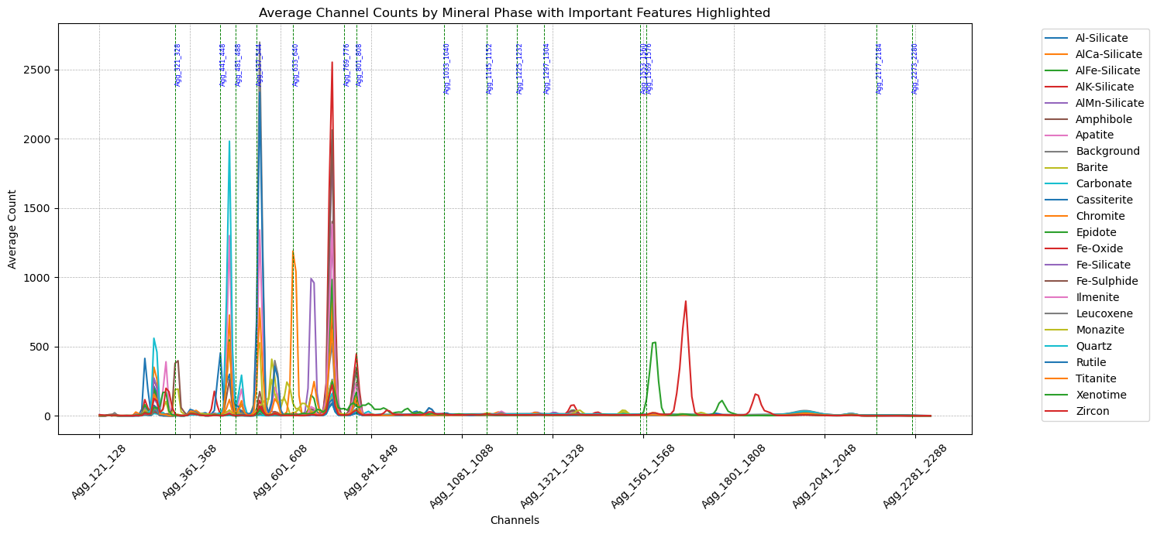
TabNet

Slide 9
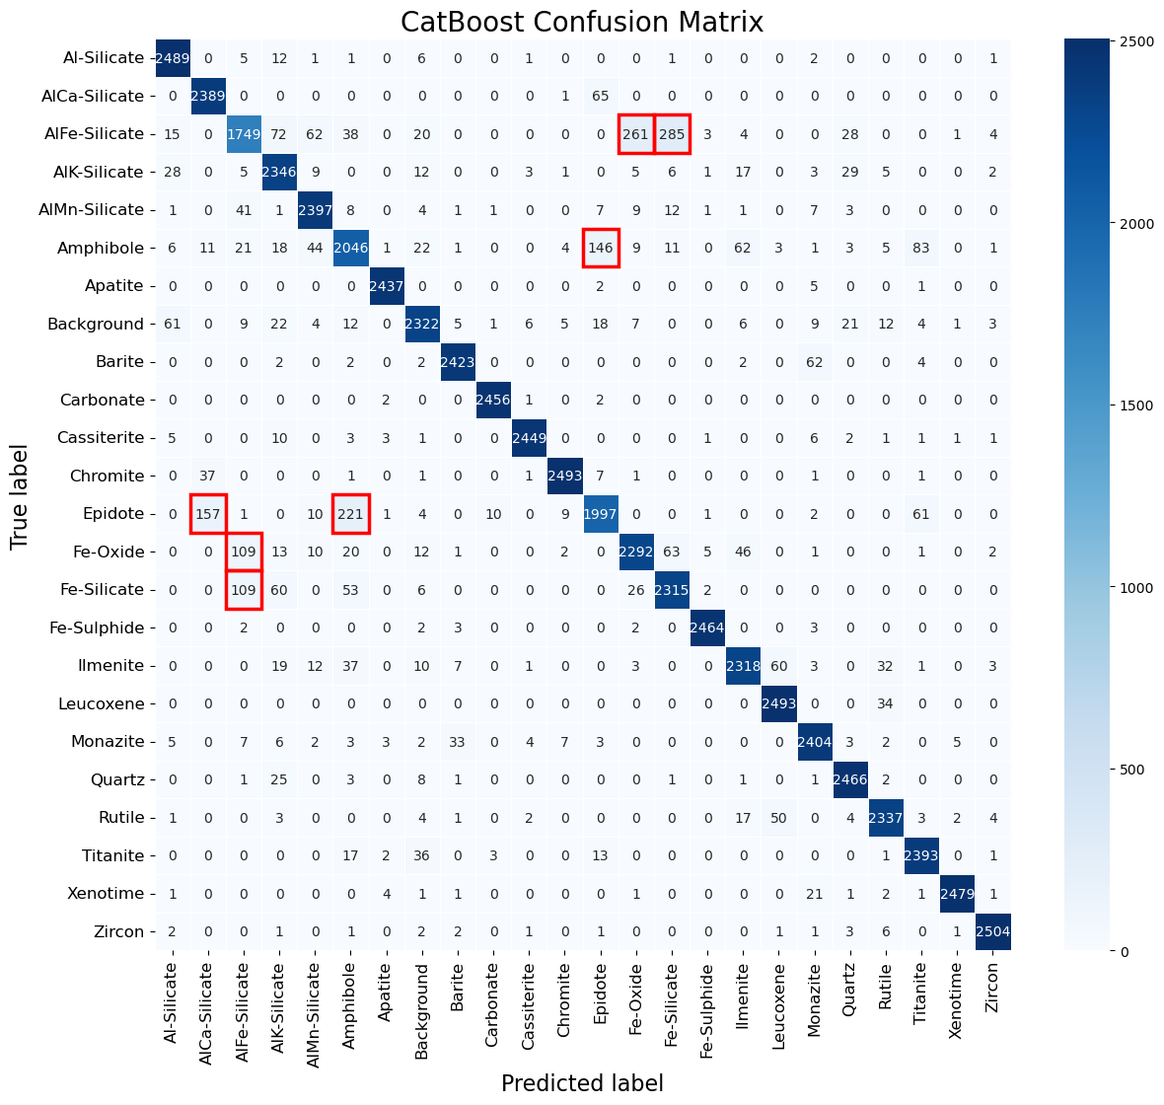
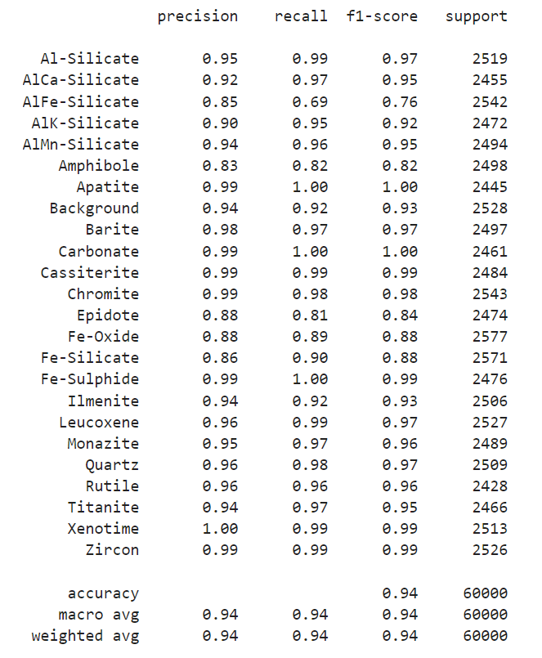
CatBoost (Category Boosting)

Slide 10
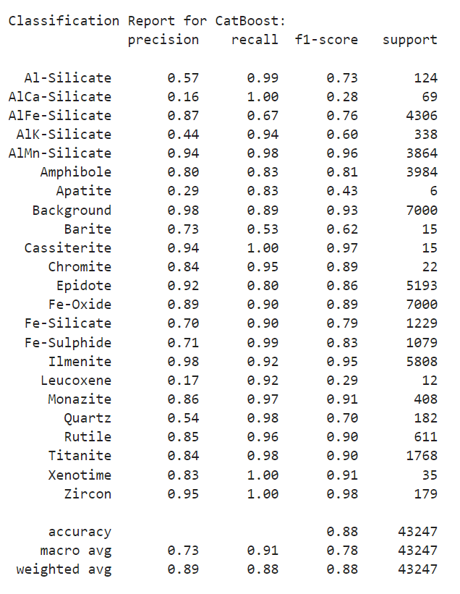
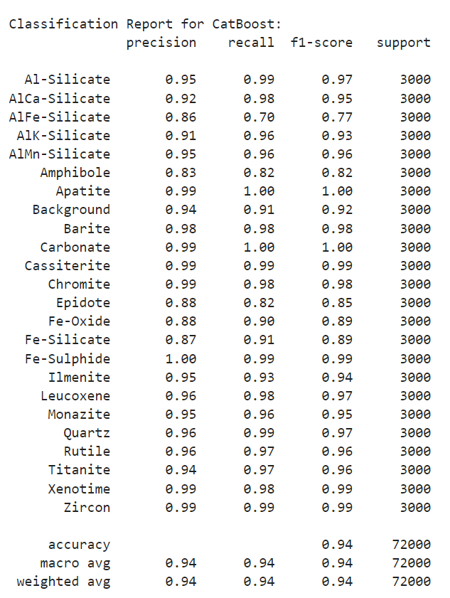
CatBoost

Slide 11
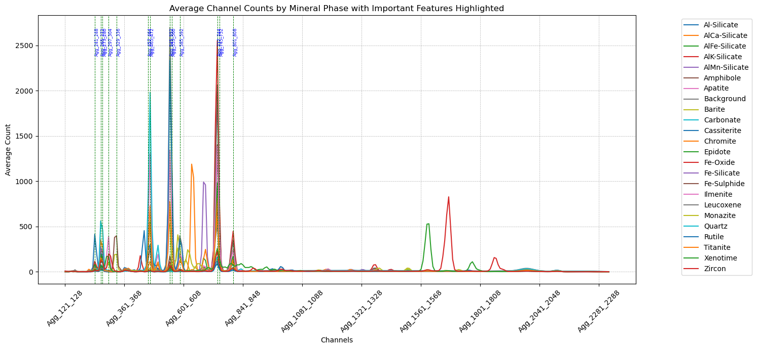
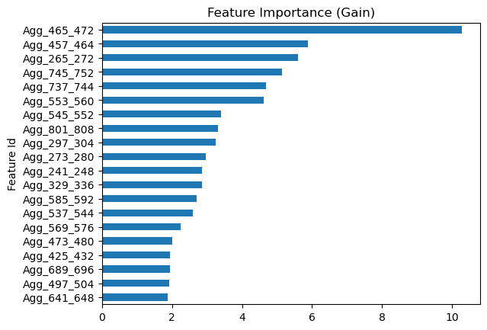
CatBoost

Slide 12
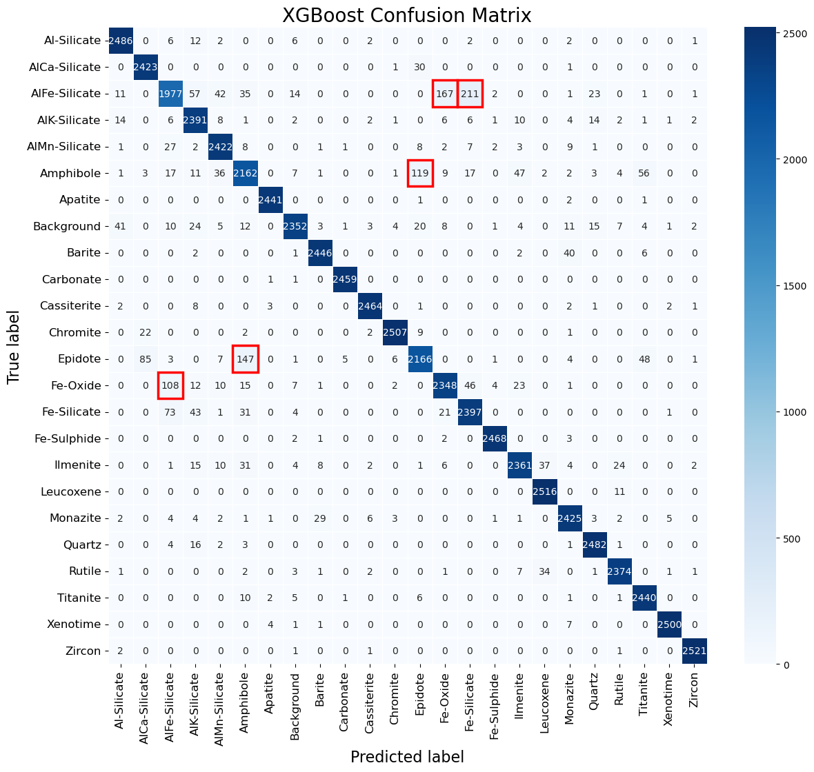
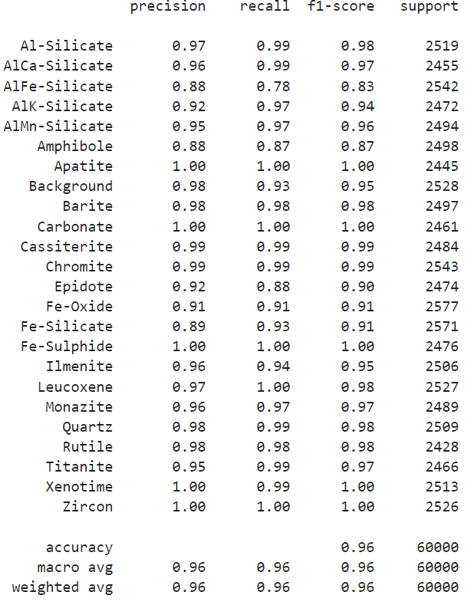
XGBoost (eXtreme Gradient Boosting)

Slide 13
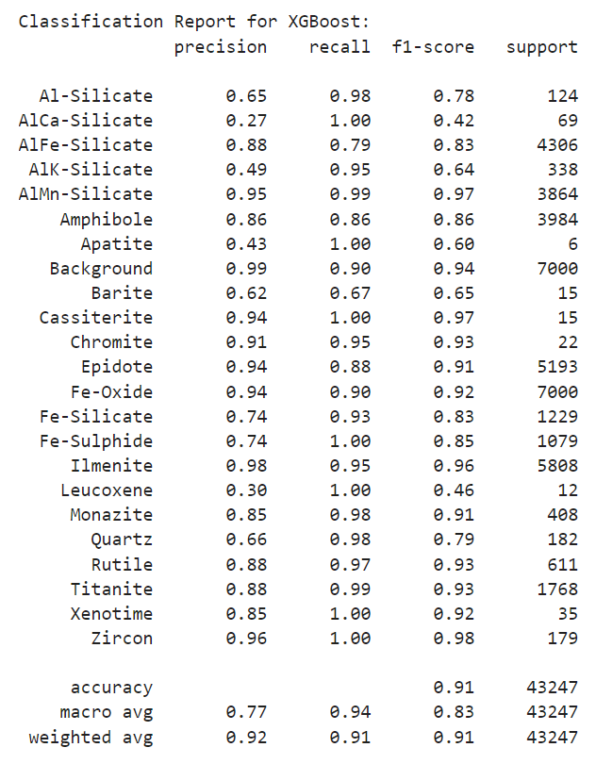
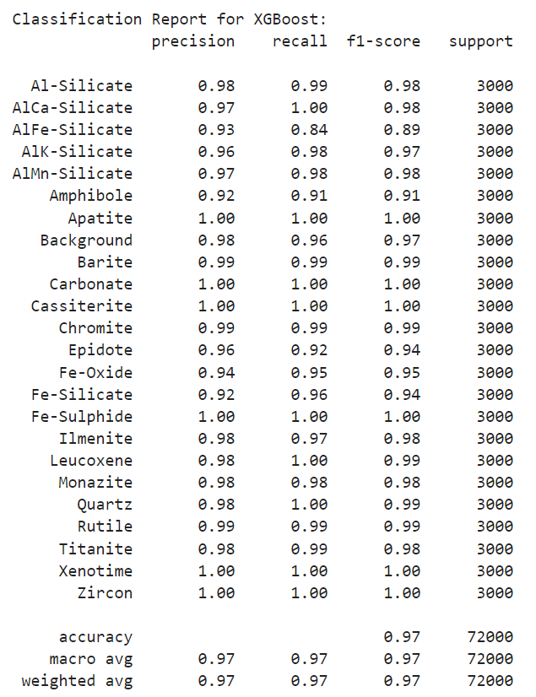
XGBoost

Slide 14
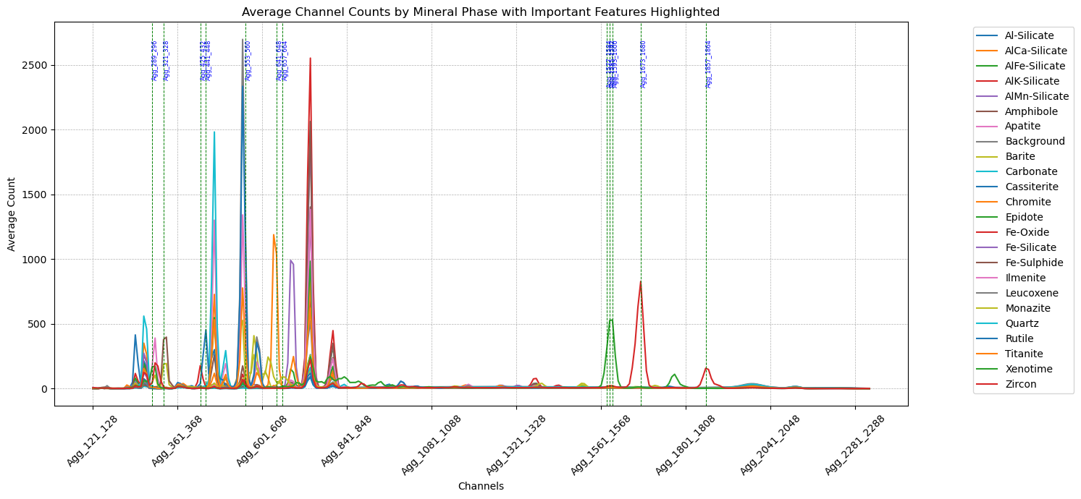
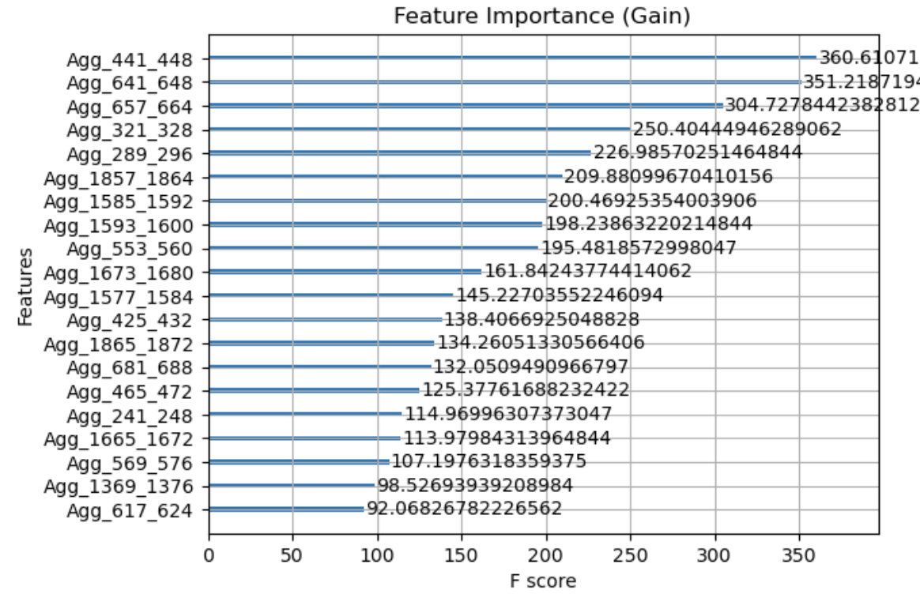
XGBoost

Slide 15
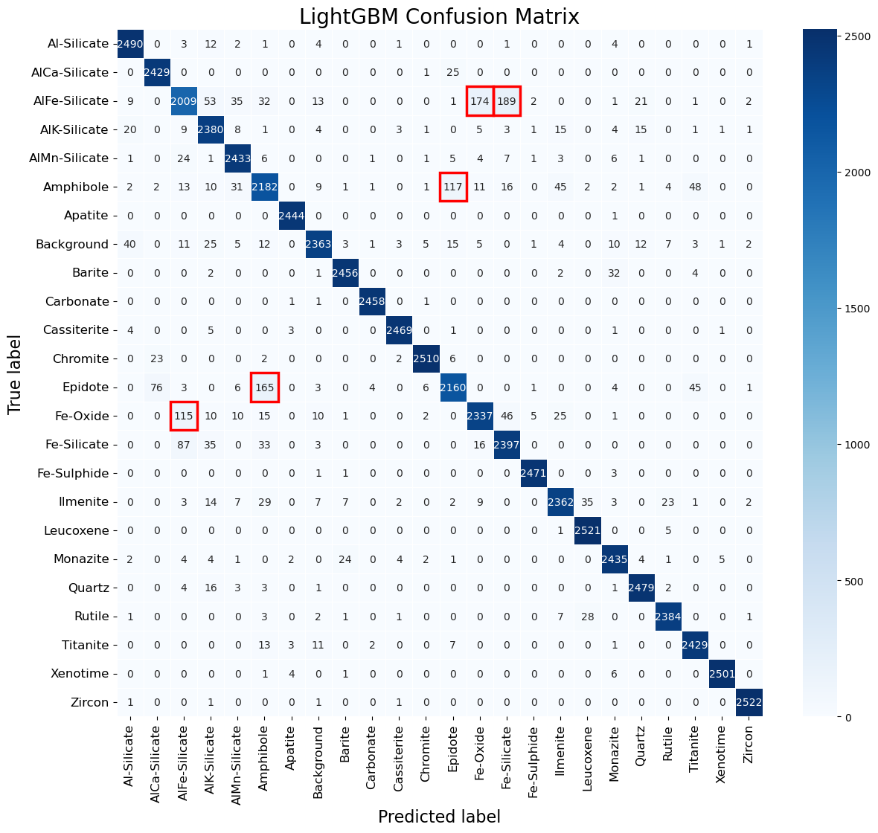
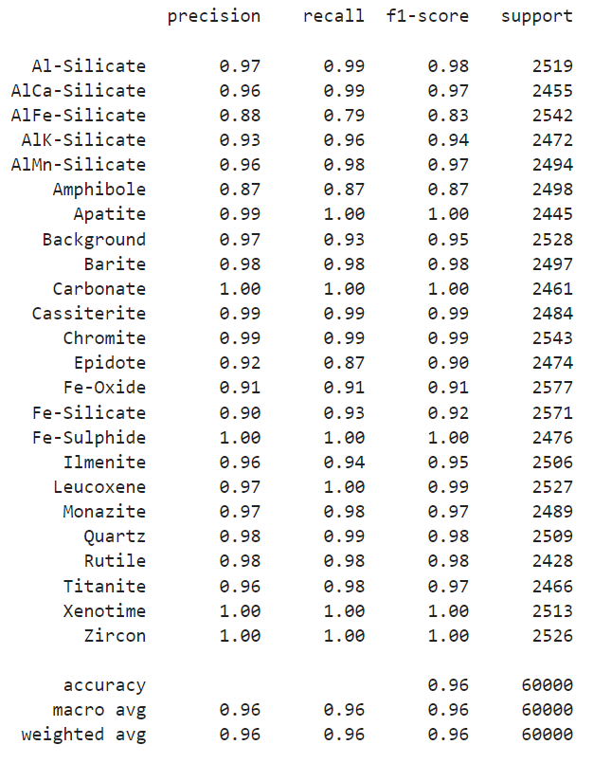
LightGBM (Light Gradient Boosting Machine)

Slide 16
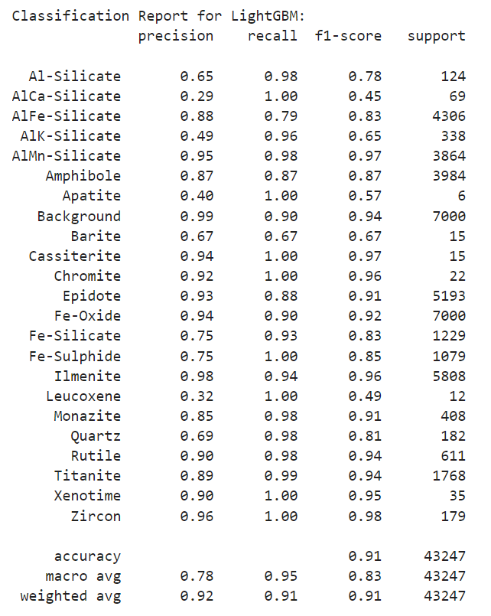
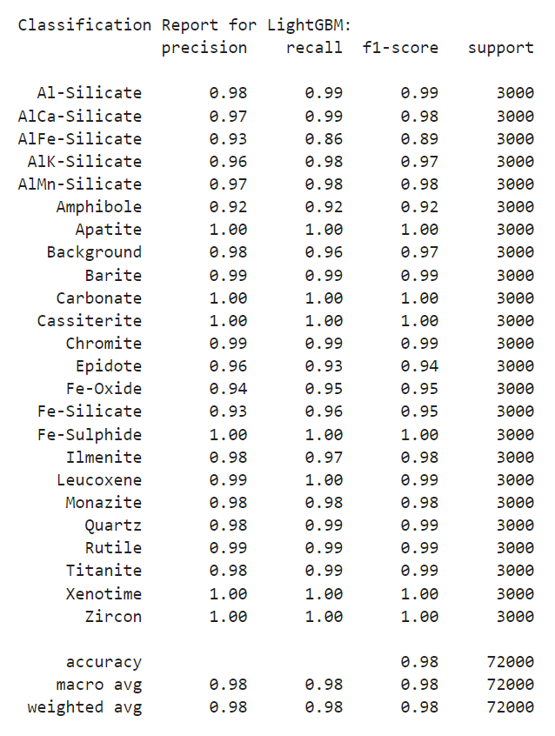
LightGBM

Slide 17
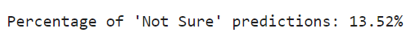
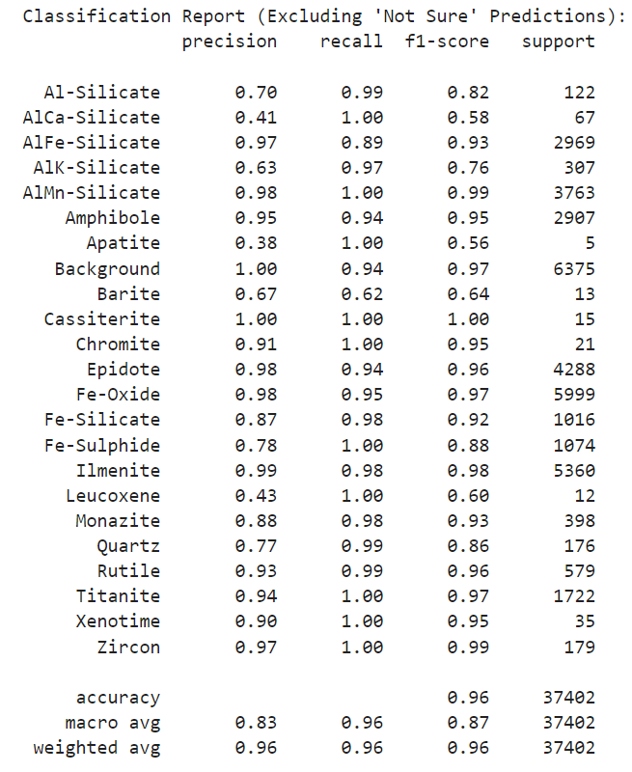
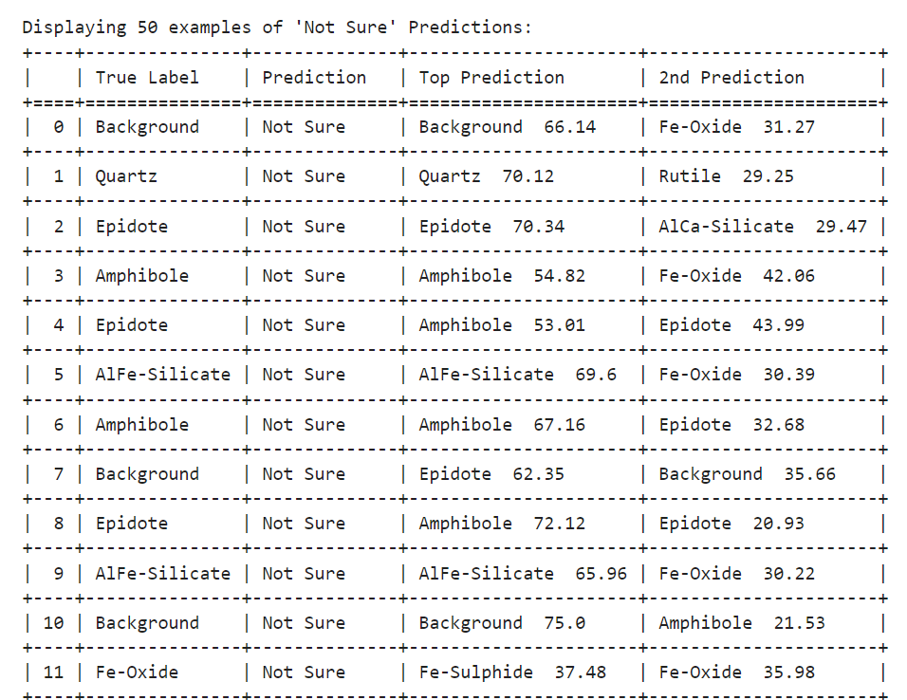
LightGBM
Get probabilities for each prediction, if the model is not confident, then predict Not Sure instead.
Threshold is 80% .

Slide 18
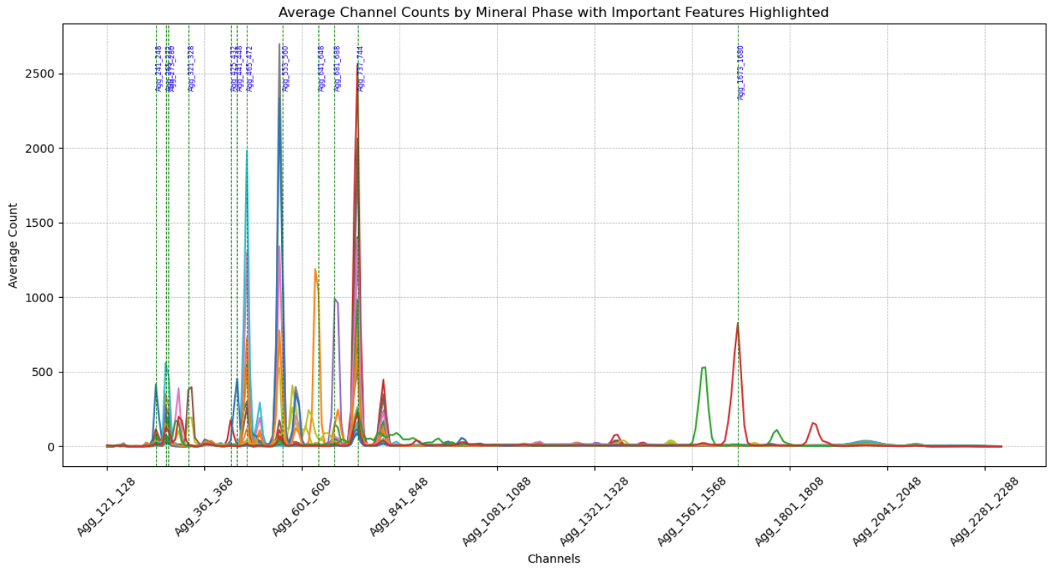
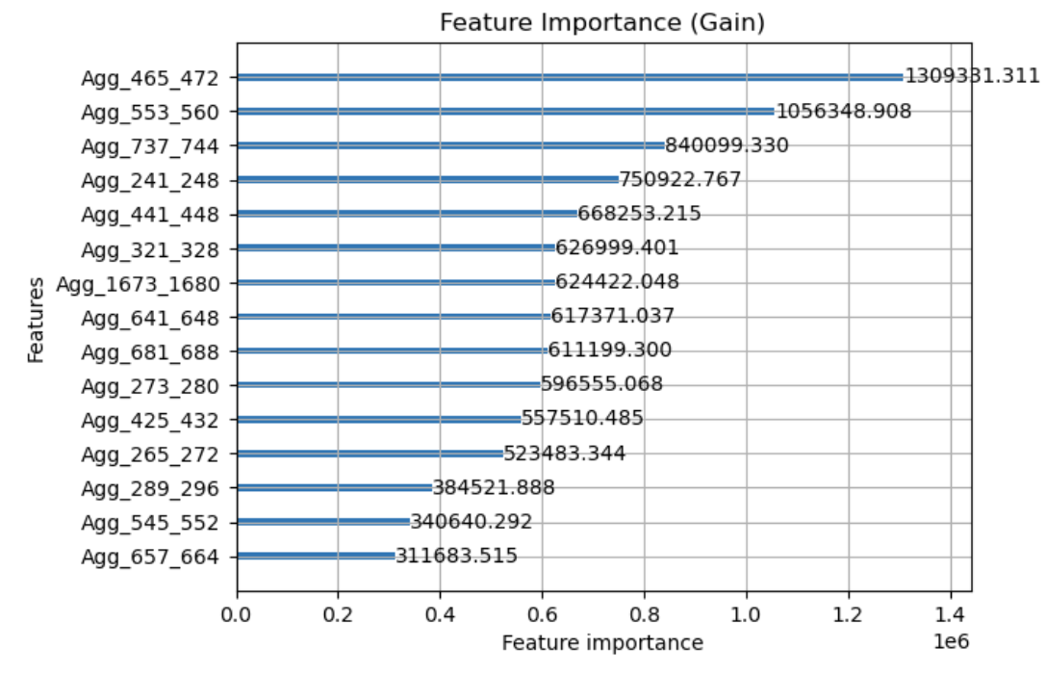
LightGBM

Slide 19
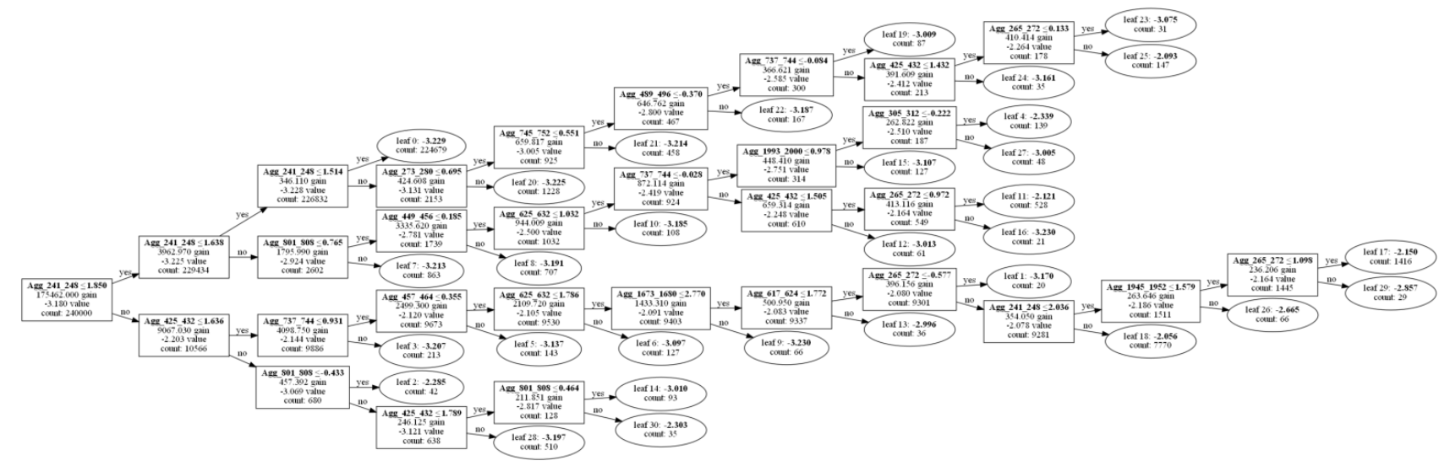
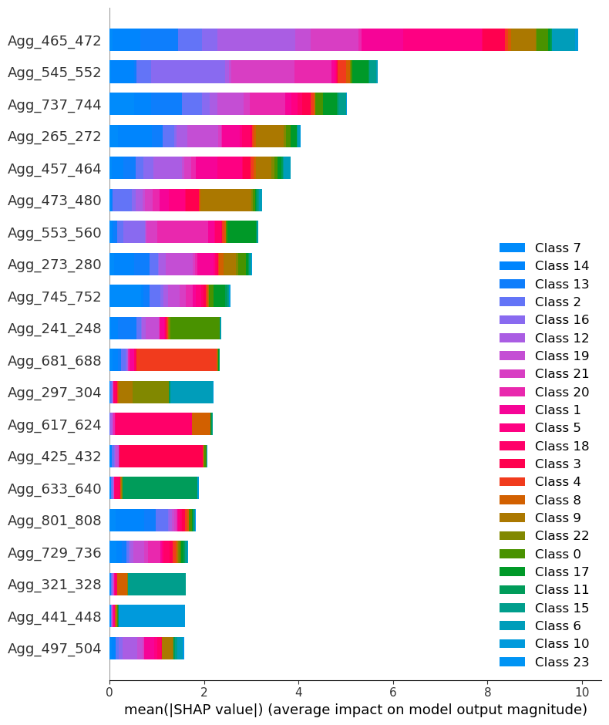
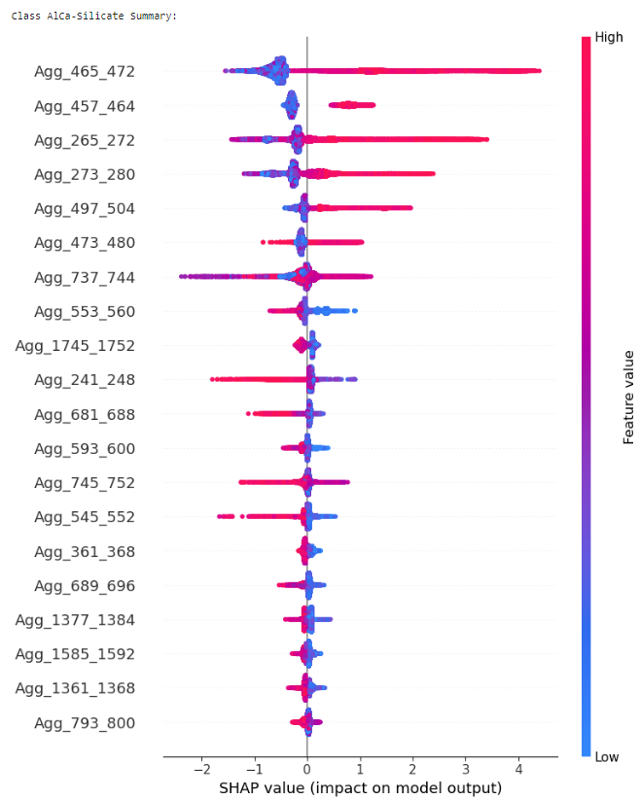
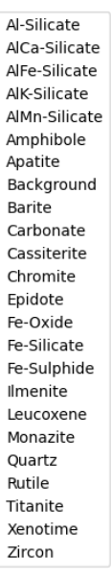
LightGBM (SHAP)

Slide 20
Summary
TabNet, XGBoost, LightGBM have relatively good results.
LightGBM has the most balanced performance as well as the best interpretation.
Given testing set, all models are making similar errors on certain mineral phases.
AlFe-Silicate vs Fe-Oxide, Fe-Silicate
Amphibole vs Epidote
Epidote vs AlCa-Silicate
Given imbalanced testing set, the recall shows the model is good at identifying those classes, but the model misclassified other classes into those classes which decreases the accuracy.
Models have shown the ability to identify the Mineral Phases.

